Slide 1
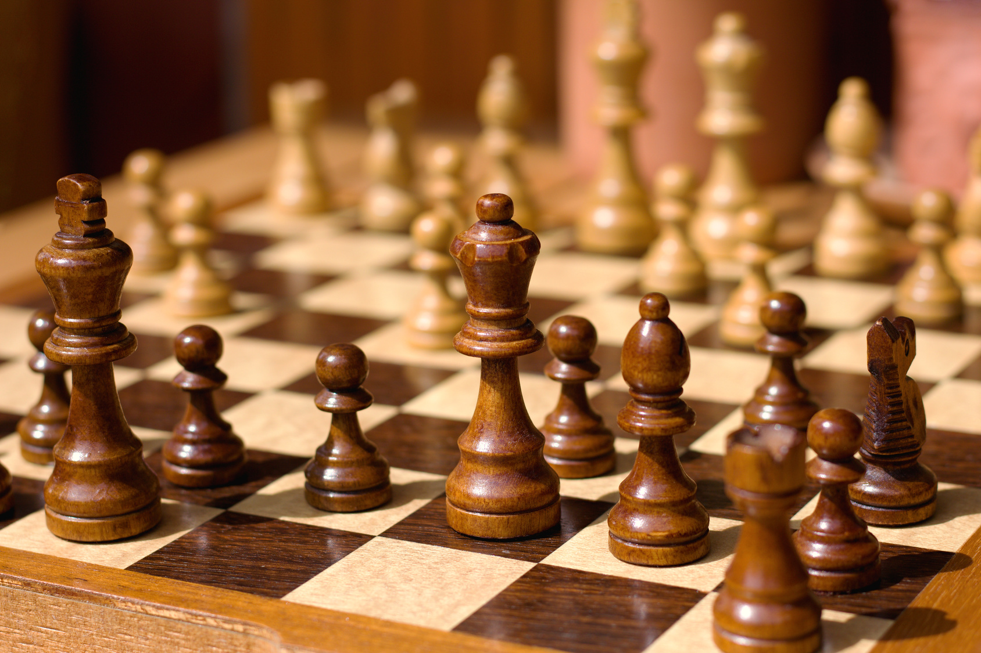
Chess-playing algorithms
Theory and implementation
Andrés García Solares

Slide 2

The contents
We’ll be building a chess playing algorithm from scratch
Making it more sophisticated as we go
We’ll also be implementing it and playing against it
No machine learning

Slide 3
Our implementation of chess (as a game)

Slide 4
chess.js
HTML + CSS + Javascript
(open source libraries)
chessboard.js
Implements chess rules and logic:
- Keeps track of the game and the pieces - Validates moves inputted - Detects piece taking, checks, checkmates
UI component:
- Displays the game - GUI for making moves
They don’t do the “AI” - WE need to implement the opponent’s logic

Slide 5
Demo time!
A first look at the code
Notes:
By looking at the progress of chess computers we can learn a lot about the historical progress of computing

Slide 6
Why have a random algorithm?
It serves as a reference against which to measure other algorithms
It serves as a stub: we can test if the program works without needing to implement an actual algorithm

Slide 7
Evaluation function

Slide 8
The engine needs to evaluate the position
Evaluation function: f(position) = evaluation
evaluation = how good or bad the position is for a given player
Convention: 0 means equal chances for both players > 0 means white is better < 0 means black is better
the bigger the number, the bigger the advantage

Slide 9
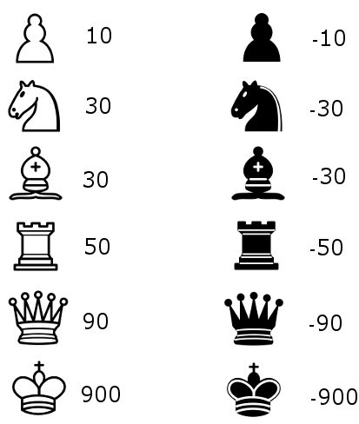
Our first evaluation function: piece values
White is up 1 knight (or equivalent)
f(pos1) = 30
Black is up 2 pawns (or equivalent)
f(pos2) = -20
Only cares about piece advantage

Slide 10
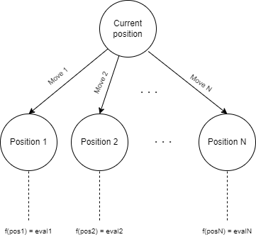
An algorithm based on our evaluation function
Make the move
that leads to the position with the highest evaluation

Slide 11
Demo time!
Piece values evaluation function

Slide 12
Minimax algorithm

Slide 13
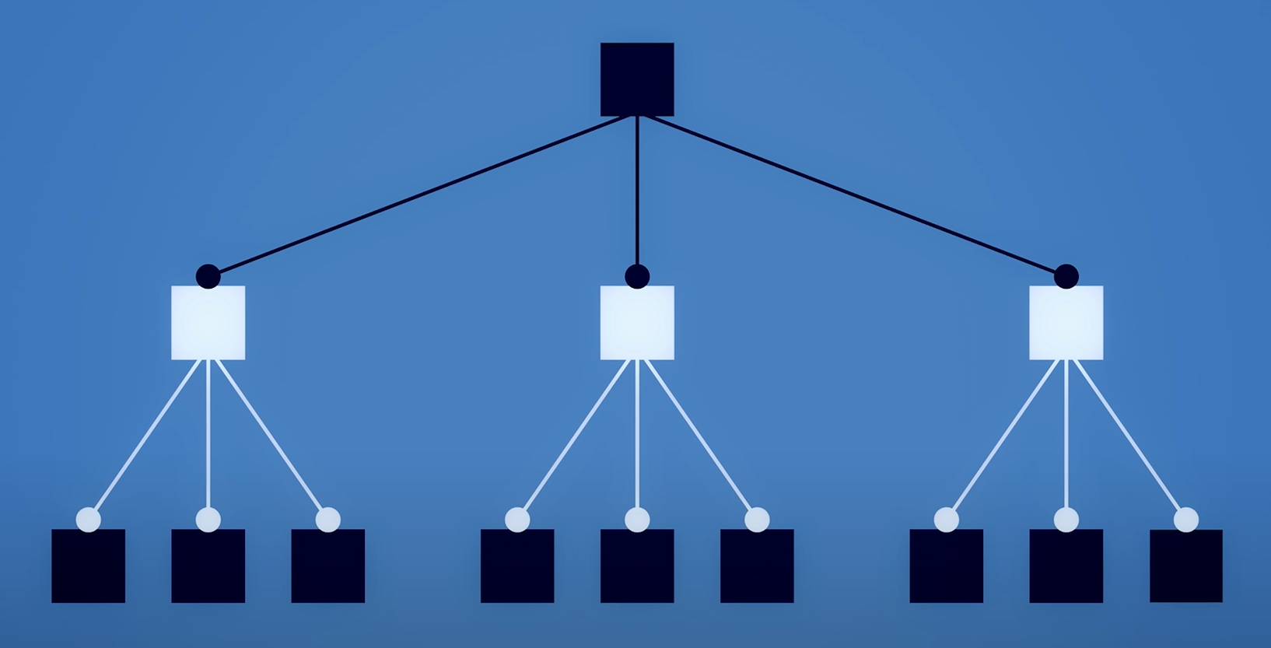
Expanding the tree
Let’s say we are playing as black...
Squares = positions
Lines = moves
Black square =
black to move
White square =
white to move
A
C
B
Notes:
Earlier we were only looking 1 move ahead, we have to look deeper

Slide 14
Let’s evaluate the leaves
Reminder: the more negative the eval, the better for black
What we would like to do
A
C
B
What white would do if we tried to do that
We need to assume white will play their best move
-60
40
0
70
-80
-90
-40
-20
-60

Slide 15
Minimax
When faced with a decision:
White tries to maximize the score Black tries to minimize it
Given the leaves’ evaluations, we work our way back
-20
A
C
B
White to move:
position eval =
MAX(possible positions)
40
70
-20
Black to move:
position eval =
MIN(possible positions)
-60
40
0
70
-80
-90
-40
-20
-60

Slide 16
Demo time!
Minimax

Slide 17
Problems with minimax
Exponential* complexity: - The deeper you make the tree, the faster it grows - And we need to go way deeper than what we just saw...
* Actually, the time complexity is O(b^{m})
m = depth of the tree b = branching factor of the tree (= number of legal moves in a position)

Slide 18
Alpha-beta pruning

Slide 19
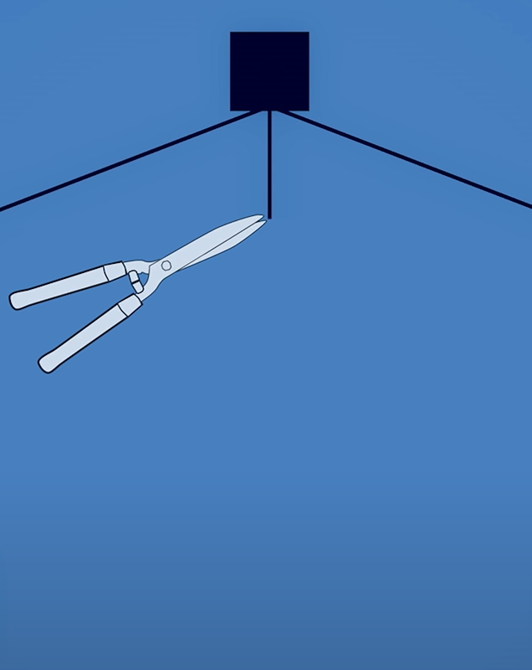
Evaluating in a smarter way
We found a move by white in branch B which is better than the best move by white in branch A.
Therefore, we (black) would never go into branch B
A
C
B
prune!
40
No need to evaluate move B
-60
40
0
70

Slide 20
Alpha-beta
α: best eval guaranteed for white (= max) in current branch
β: best eval guaranteed for black (= min) in current tree level
if α > β: prune branch
α = -∞
β = ∞
α = 40
β = 40
α = -60
β = ∞
α = 40
β = ∞
α = 70
β = 40
A
C
B
α > β
40
prune branch
-60
40
0
70

Slide 21
Alpha-beta
α: best eval guaranteed for white (= max) in current branch
β: best eval guaranteed for black (= min) in current tree level
if α > β: prune branch
When the level that is being explored is black to move instead of white to move, then the way α and β are updated is switched
This way, we prune
branches we
wouldn’t go into
AND also
branches the opponent wouldn’t go into
α: best eval guaranteed for white (= max) in current tree level β: best eval guaranteed for black (= min) in current branch
if α > β: prune branch

Slide 22
Demo time!
Alpha-beta pruning

Slide 23
Minimax vs alpha-beta pruning
Alpha-beta pruning is just a smarter minimax: - reaches the same results as minimax - but faster
Complexity depends on the order in which the branches are visited - worst case scenario: we are unable to do any pruning O(b^{m}) (same as minimax)
- best case scenario: we prune everything as we go O(b^{m/2})
Notes:
worst case occurs when we cant do any pruning because good moves are on right side of tree and the ordering is from worst to best moves, left to right, order in which we visit. best case occurs when good moves in left side of tree and we find them first.

Slide 24
Heuristics

Slide 25
What is a heuristic?
A shortcut that aids a search algorithm
Based on: - Theoretical knowledge about the subject - Real-world observation / empirical data - Rules of thumb
Trade-off: The answer given by a heuristic is not guaranteed to be optimal or complete, but it will be quick and “close enough”

Slide 26
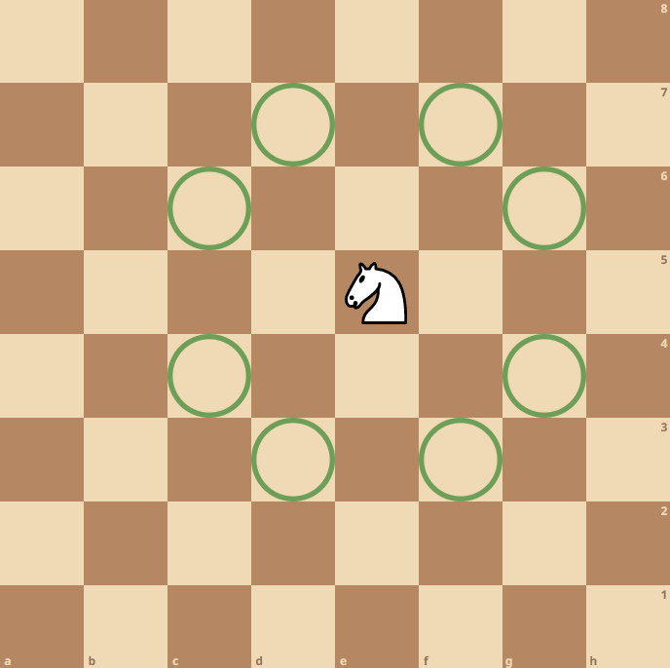
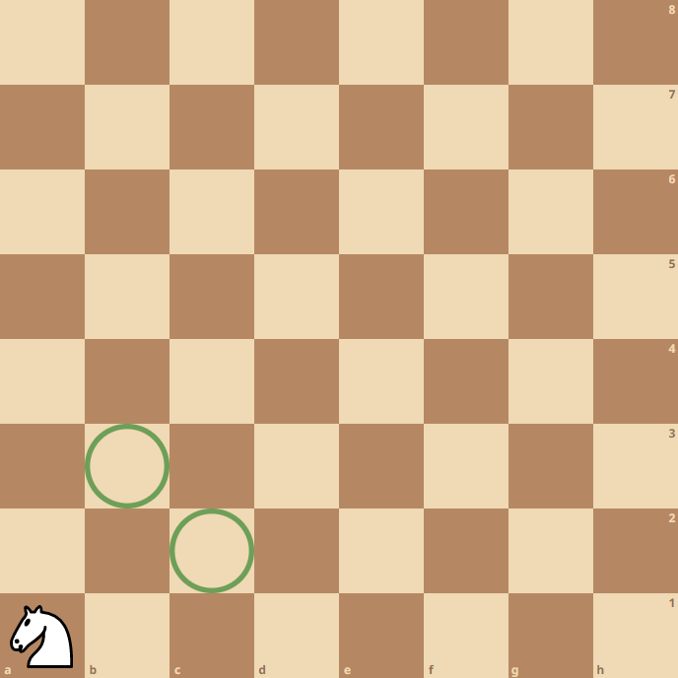
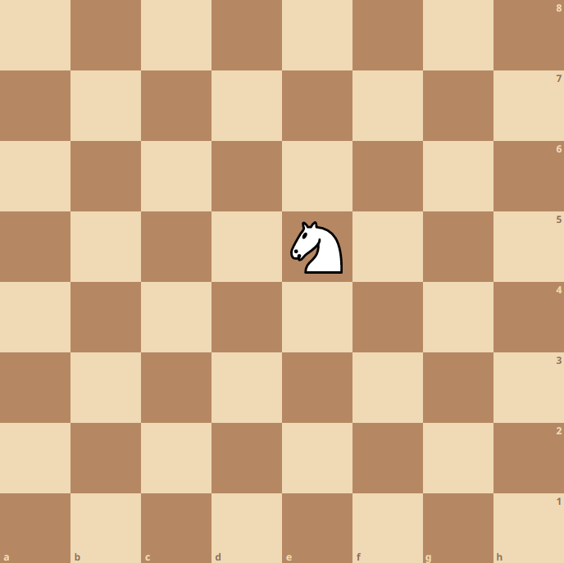
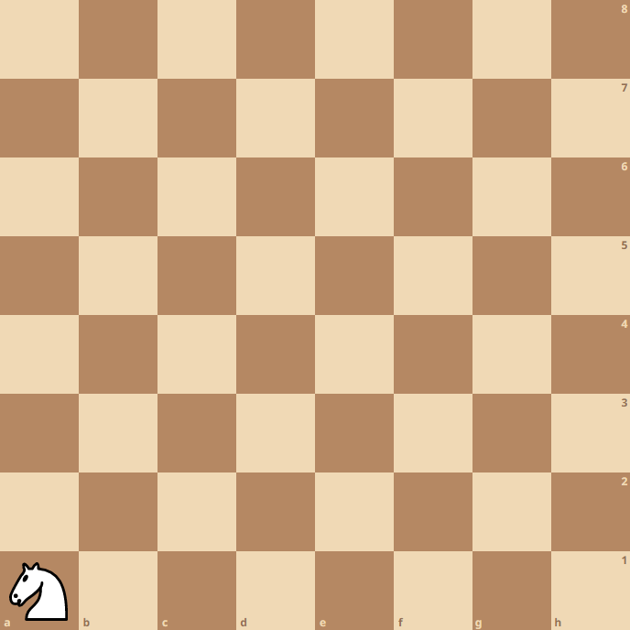
Our heuristic: piece positioning
VS

Slide 27
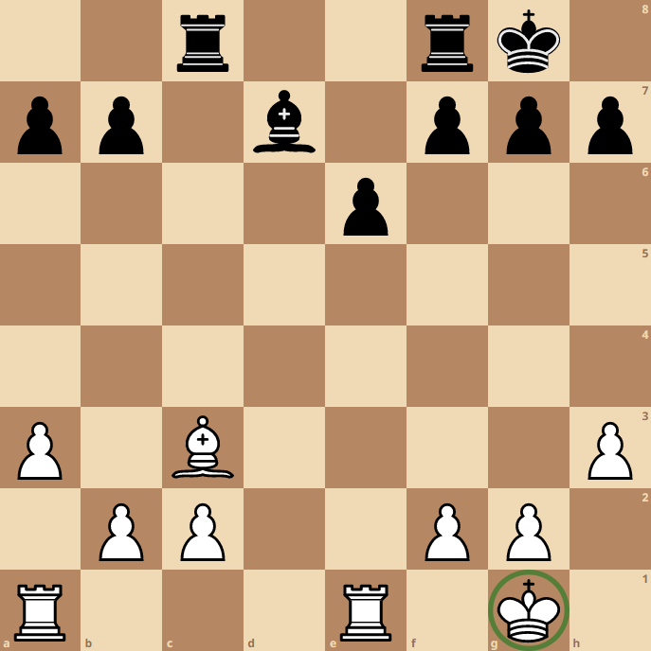
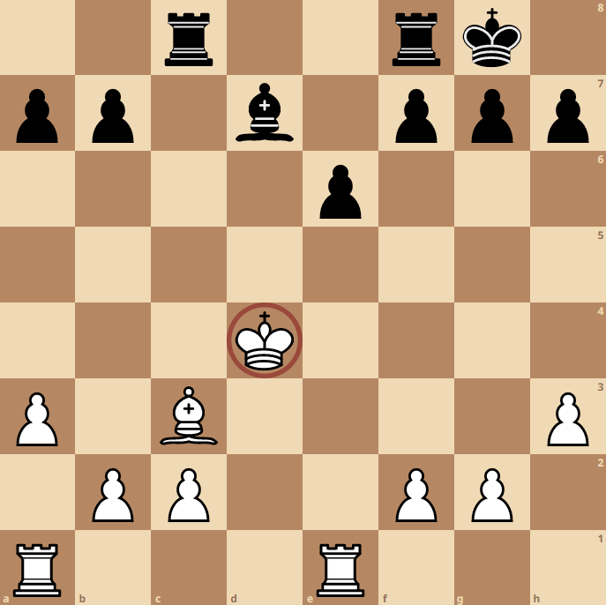
Our heuristic: piece positioning
VS

Slide 28
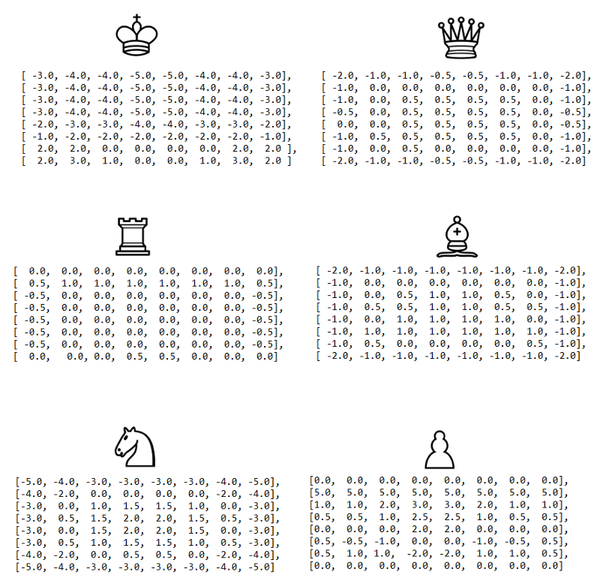

Slide 29
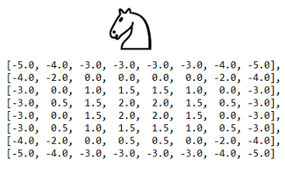
Improved evaluation function
Based on the positioning of the piece, apply a modifier to its value according to the chart
This knight is worth 30 + 2 = 32
This knight is worth 30 - 5 = 25

Slide 30
Demo time!
Heuristics

Slide 31
The end!
Any questions?
The code: https://github.com/andresgsol/winter-campus-2022-chess/
How to improve the algorithm further: https://en.wikipedia.org/wiki/Monte_Carlo_tree_search https://www.chessprogramming.org/Opening_Book

